Slide 1
Probability & Random Processes EE-2011 Department of Electrical Engineering
NATIONAL UNIVERSITY OF COMPUTER & EMERGING SCIENCES, LAHORE CAMPUS

Slide 2
Statistics
Statistics is a very very vey …. old subject!
How old do you think?
As older as the humans?
It’s about the:
Collection
Organization
Presentation
Interpretation, and
Analysis of Information

Slide 3
Some Questions to Ponder
What can be the sources of information data?
Can information data be static or non varying?
Can information data be varying?
Can information data be certain?
Is information data always certain?
All these questions relate to Statistics!

Slide 4
Some Terminologies
Experiment describes the process that generates a set of data
Some experiments generate data that is subject to uncertainties
Do most experiments generate data that is subject to uncertainties?
Recording of information is Observation
Categorical data is classified according to some criteria
Statistics is about “Chance Outcome” that occurs in a planned study or investigation
There are three types of Statistical Studies
Designed Experiment
Observational Studies
Retrospective studies

Slide 5
Statistical Studies
Designed Experiment
Design of experiments (DOE) deals with planning, conducting, analyzing, and interpreting controlled tests
to evaluate the factors
that control the value of a parameter.
Observational Studies
An observational study draws inferences from a sample to a population
where the independent variable is not under the control of the researcher
because of ethical concerns or logistical constraints
Retrospective studies
A retrospective study is performed
a posteriori, using information on events that have taken place in the past.
A posteriori, Latin for "from the latter", is a term from logic, which usually refers to reasoning that works backward from an effect to its causes.
in a way, based on reasoning from known facts or past events, rather than by making assumptions or predictions.

Slide 6

2.1 Sample Space
The set of all possible outcomes of a statistical experiment is called the Sample Space and is represented by the symbol S.
Each outcome in a sample space is called an element
or a member of the sample space,
or simply a sample point.
If the sample space has a ﬁnite number of elements,
we may list the members separated by commas and enclosed in braces.
Thus, the sample space S, of possible outcomes when a coin is ﬂipped, may be written

Slide 7




Slide 8
Sample Space
What did Example 2.1 illustrate?
the fact that more than one sample space can be used to describe the outcomes of an experiment
In this case, S₁ provides more information than S₂
If we know which element in S₁ occurs we can tell which outcome in S₂ occurs
However, a knowledge of what happens in S₂ is of little help in determining which element in S₁ occurs
In general, it is desirable to use the sample space that gives the most information concerning the outcomes of the experiment
In some experiments, it is helpful to list the elements of the sample space systematically by means of a tree diagram

Slide 9

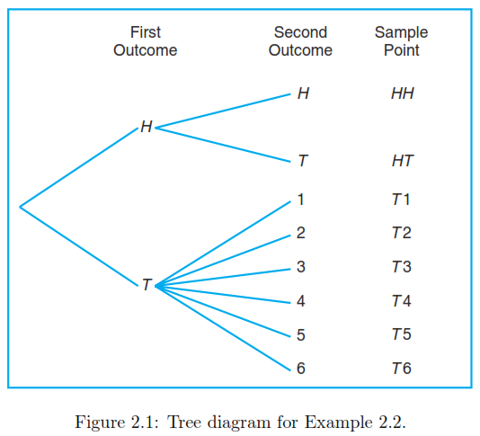

Slide 10



Slide 11

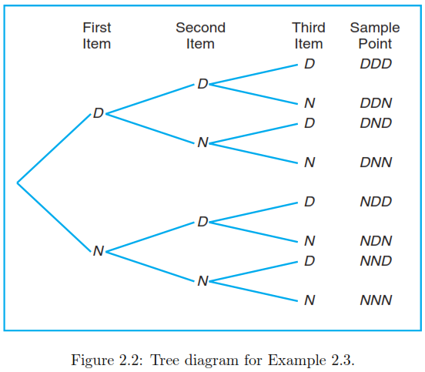
Draw Tree diagram of example 2.3

Slide 12


Slide 13



